Slide 1

Lab: How does light affect photosynthesis?
Expectations …
What’s the effect of light intensity?
According to Einstein, more photons/second
What’s the effect of light wavelength?
Since $E_{photon}=\frac{hc}{λ}$
longer wavelength -> less energy/photon
Shorter wavelength -> more energy/photon
Your observations …
Notes:
This is the simple cartoon I use to introduce photosynthesis to students.

Slide 2
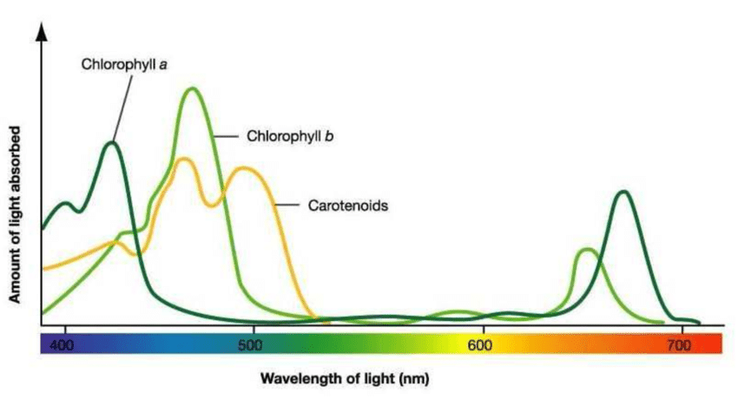
Absorption spectra of photosynthesizing pigments
Blue light should be pretty _____ for all pigments
Red light should be pretty _____ for chlorophyll but _____ for carotenoids
Blue-green light should be _____ for carotenoids but _____ for chlorophyll
Yellow light should be _____ for all pigments
https://www.researchgate.net/profile/Mohammad_Aboonajmi/publication/308657173/figure/fig1/AS:410895856488453@1474976615139/Absorption-spectra-of-chlorophyll-and-carotenoids-From-wwwcfbunhedu.png

Slide 3
Absorption spectra of photosynthesizing pigments
Blue light should be pretty good for all pigments
Red light should be pretty good for chlorophyll but bad for carotenoids
Blue-green light should be good for carotenoids but bad for chlorophyll
Yellow light should be bad for all pigments
https://www.researchgate.net/profile/Mohammad_Aboonajmi/publication/308657173/figure/fig1/AS:410895856488453@1474976615139/Absorption-spectra-of-chlorophyll-and-carotenoids-From-wwwcfbunhedu.png

Slide 4
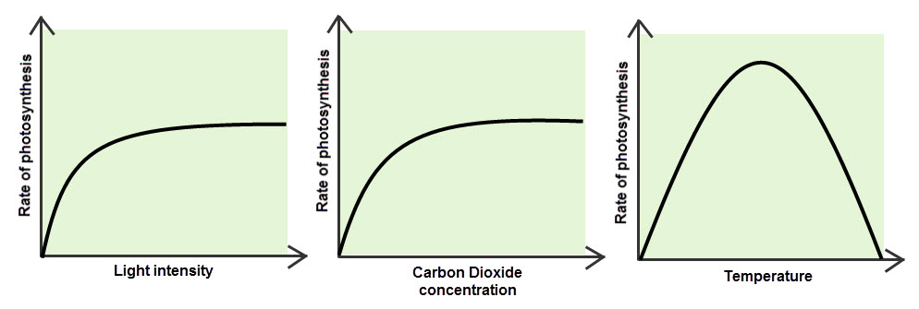
Photosynthesis in a changing climate

Slide 5
Photosynthesis in a changing climate
Less cloudy →
← More cloudy

Slide 6
Photosynthesis in a changing climate
Less cloudy →
← More cloudy
=> Impacts depend on how cloudy a region is now

Slide 7
Photosynthesis in a changing climate
Increasing atmospheric CO₂ →
Less cloudy →
← More cloudy
=> Impacts depend on how cloudy a region is now

Slide 8
Photosynthesis in a changing climate
Increasing atmospheric CO₂ →
Less cloudy →
← More cloudy
=> Impacts depend on how cloudy a region is now
=> CO₂ fertilization is a real thing, but saturates quickly

Slide 9
Photosynthesis in a changing climate
Increasing atmospheric CO₂ →
Less cloudy →
← More cloudy
Canada
Tropics
=> Impacts depend on how cloudy a region is now
=> CO₂ fertilization is a real thing, but saturates quickly

Slide 10
Photosynthesis in a changing climate
Increasing atmospheric CO₂ →
Less cloudy →
← More cloudy
Canada
Tropics
=> Impacts depend on how cloudy a region is now
=> CO₂ fertilization is a real thing, but saturates quickly
=> Warming might promote photosynthesis in Canada, but not in the tropics

Slide 11
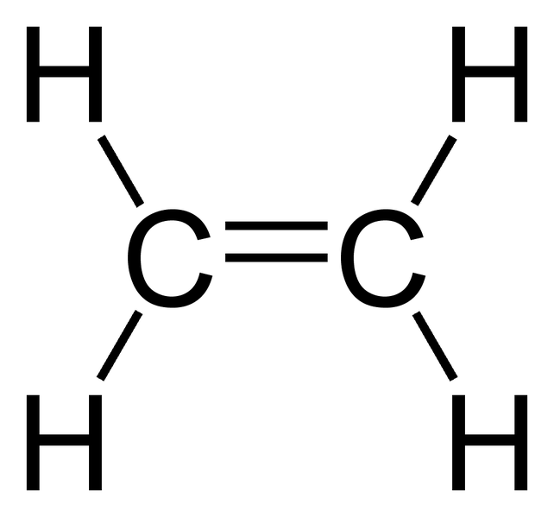
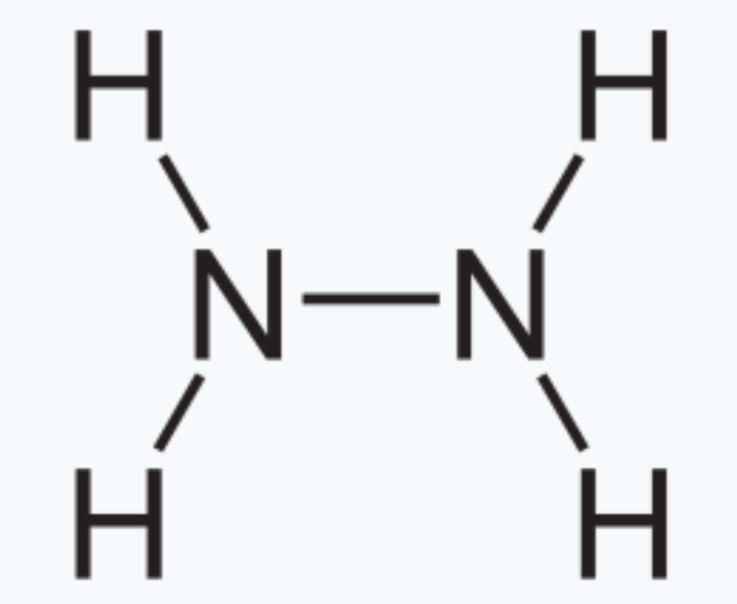

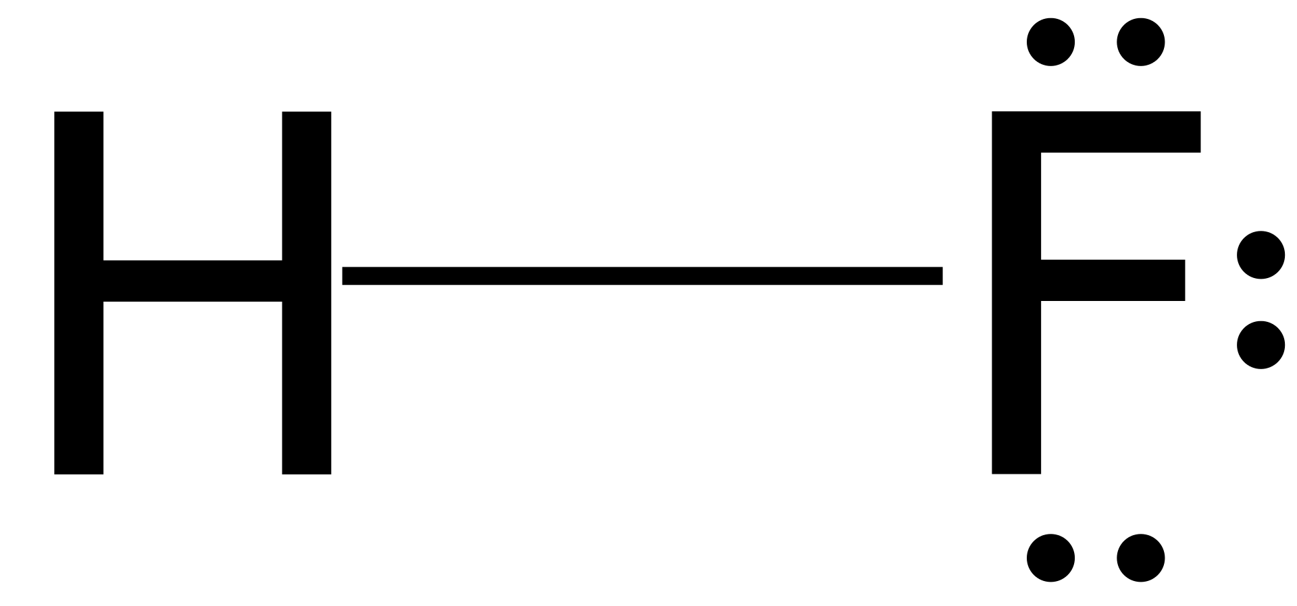
Valence method and the duet/octet rule
The valence method (AKA bond # rule) lets us draw molecular structures (lines)
Carbon family makes 4 bonds
Nitrogen family makes 3 bonds
Oxygen family makes 2 bonds
Halogens and Hydrogen make 1 bond
The duet/octet rule let us add in electrons to make Lewis structures (lines+dots):
Two electrons for Hydrogen (paired in a duet)
Eight electrons for C, N, O, and F (four pairs, called an octet)

Slide 12
Limitations of the valence method and the duet/octet rule
Molecules we know exist, but magnetic behavior tells a different story
Molecules we know exist, for which the valence method doesn’t work
Atoms in row 3 of the periodic table or below don’t have to obey the octet rule

Slide 13
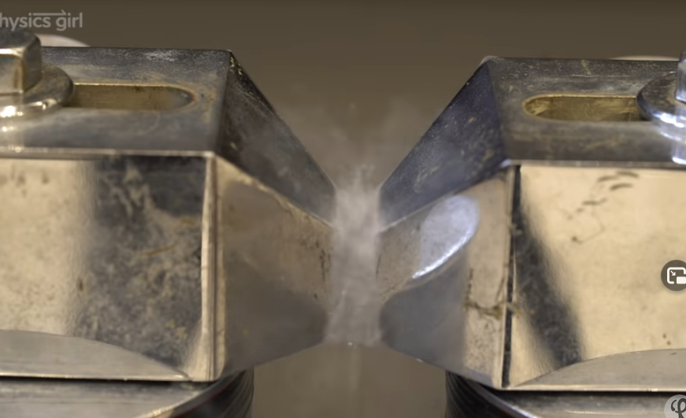
1. Molecules we know exist, but magnetic behavior tells a different story
resonance
O O
Satisfies octet rule; Maybe weight this 60%
Consistent with magnet experiment;
Maybe weight this 40%

Slide 14
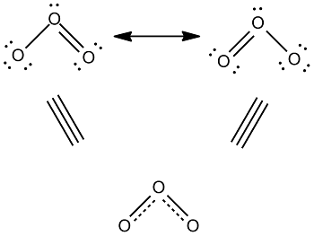
2. Molecules we know exist, for which the valence method doesn’t work

Slide 15
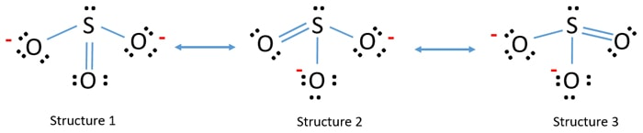
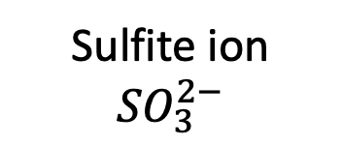
3. Atoms in row 3 and below don’t have to obey the octet rule
Sulfite ion
$${SO}_{3}^{2−}$$
Resonance-averaged bond order = $1\frac{1}{3}$
Resonance-averaged formal charge on oxygens = $−\frac{2}{3}$

Slide 16
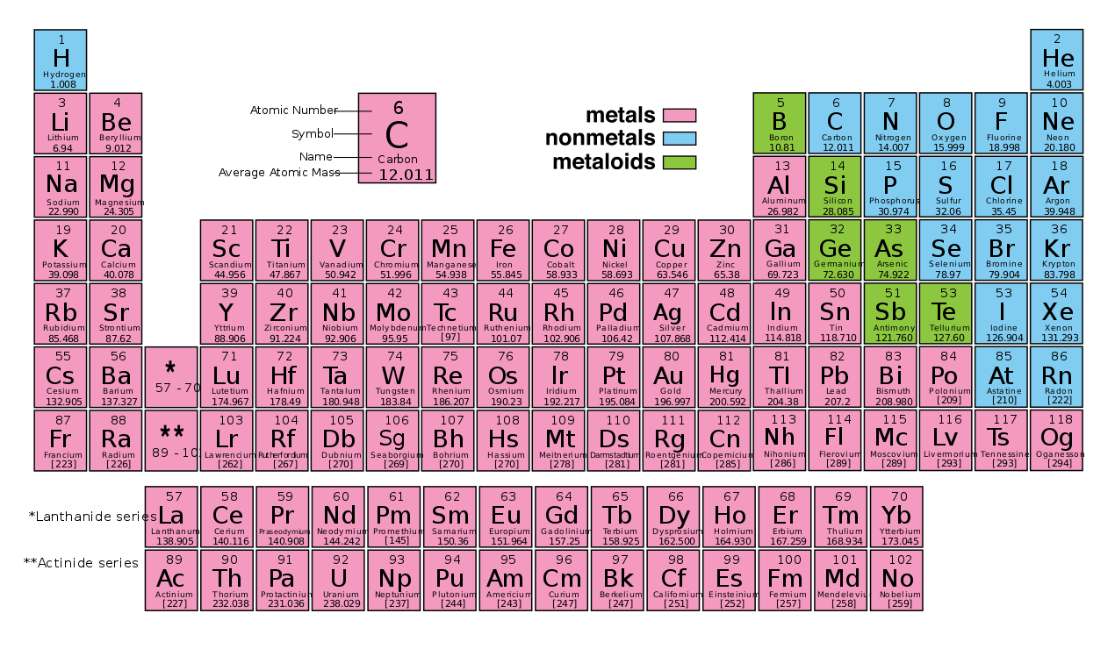
These are really the only elements for which the “octet rule” is useful
The “octet rule” should probably be called the “octet exception”

Slide 17
X-Y-Z delocalization, allylic lone pairs, and resonance
X
Y
Z
resonance
X
Y
Z
resonance

Slide 18
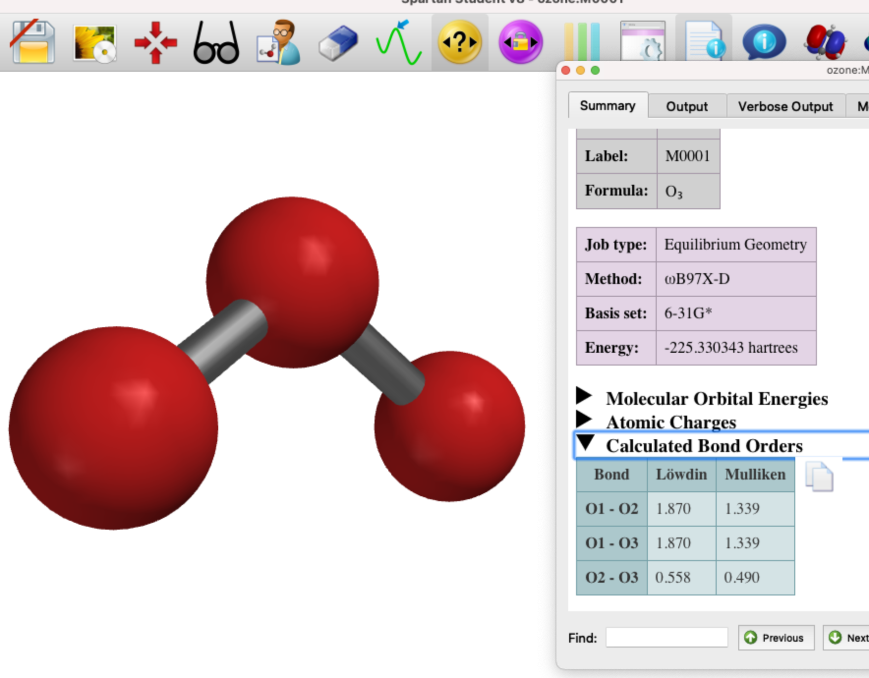
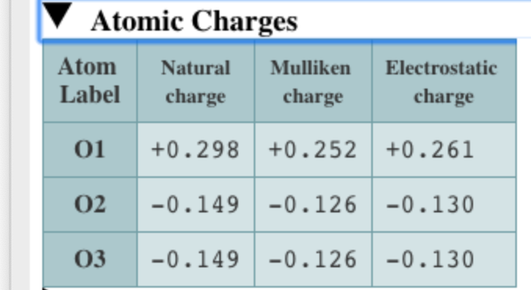
Comparisons to Spartan: charges and bond orders
+
-
-

Slide 19
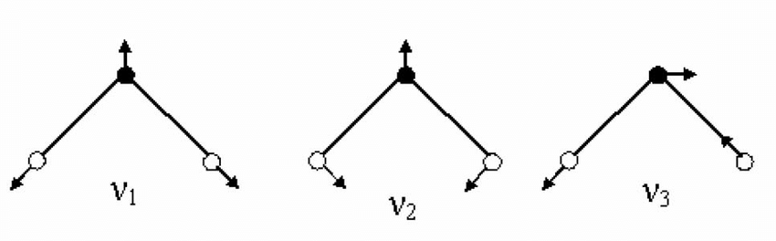
Why the charges are important: they enable the molecule to be IR-active
+
+
-
-
-
-
Symmetric stretch
Asymmetric stretch
Bend

Slide 20
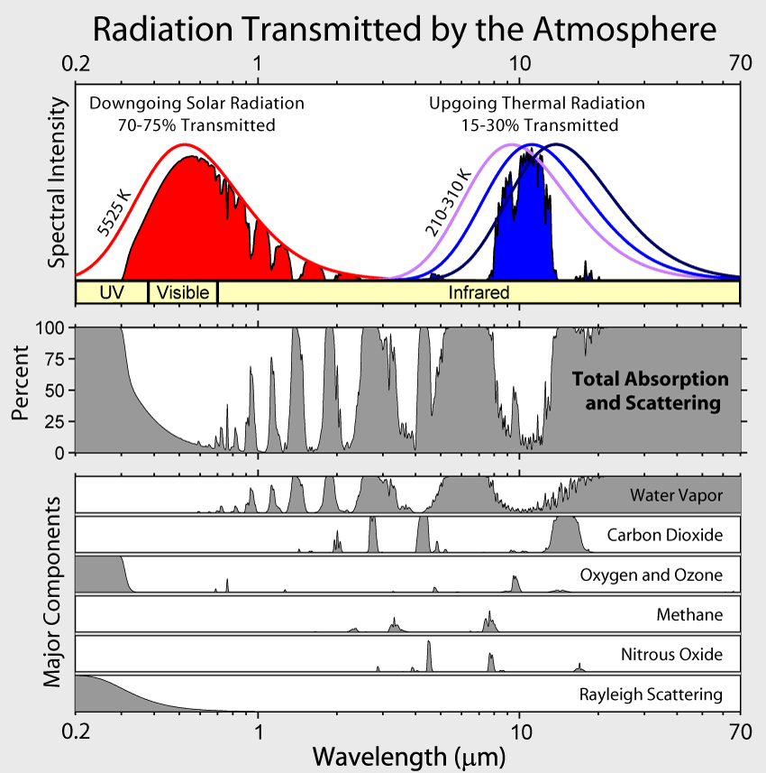
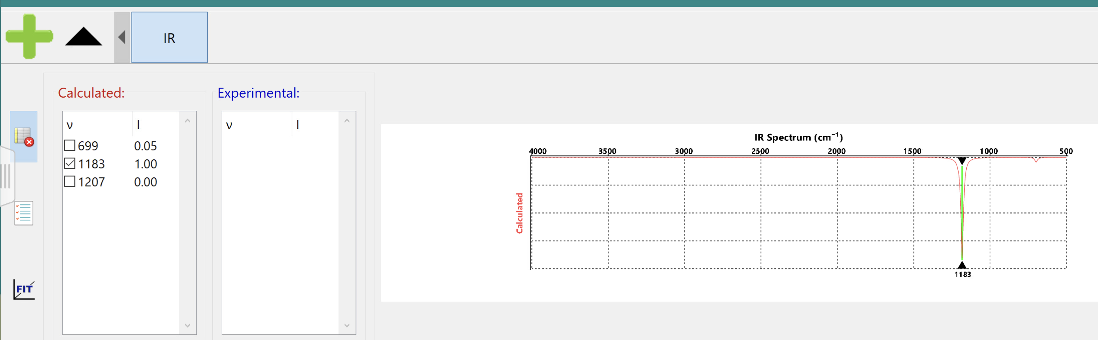
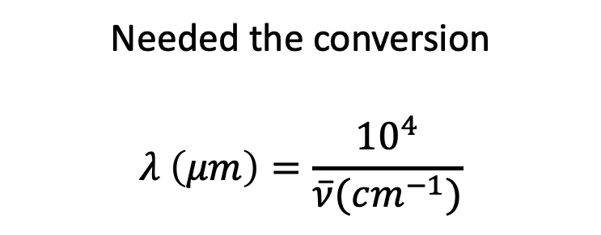
That peak in the 8−12 𝜇𝑚 window is the asymmetric stretch of O₃
Needed the conversion
$$λ \left(μm\right)=\frac{{10}^{4}}{\overline{ν}(cm^{−1})}$$

Slide 21
The ozone hole

Slide 22
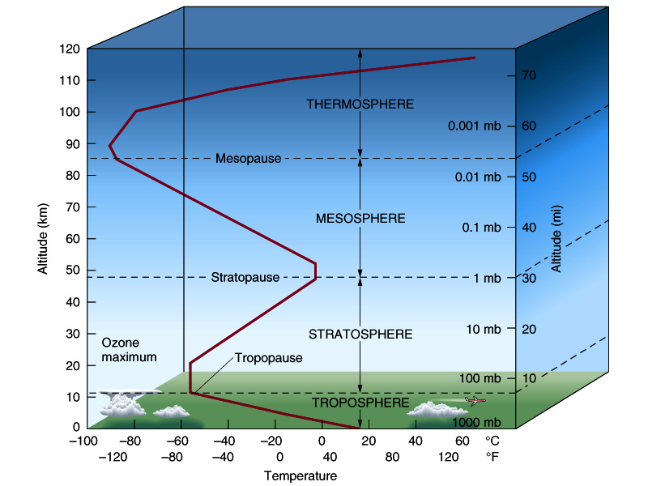
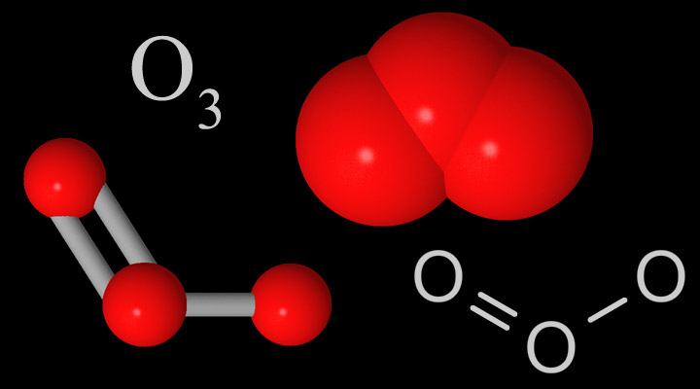
Ozone occurs mainly in the stratosphere

Slide 23
Two reasons that less stratospheric ozone => colder stratosphere
Ozone absorbs ultraviolet light from the sun (we need that!)

Slide 24
Two reasons that less stratospheric ozone => colder stratosphere
Ozone absorbs ultraviolet light from the sun (we need that!)
Ozone also absorbs longwave (IR) light from the earth

Slide 25
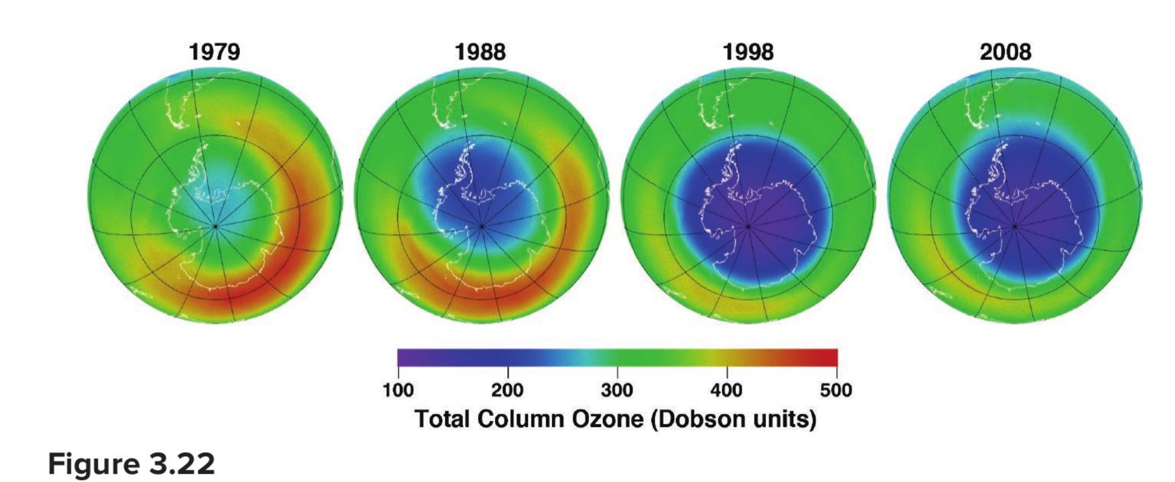
But humans have been destroying ozone, especially in the Antarctic

Slide 26
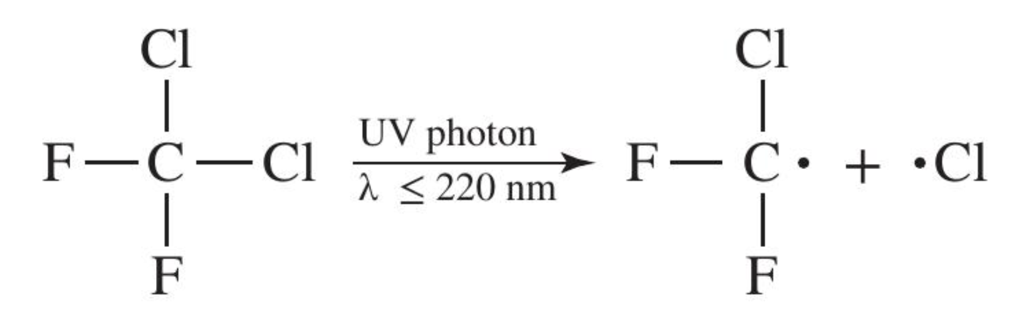
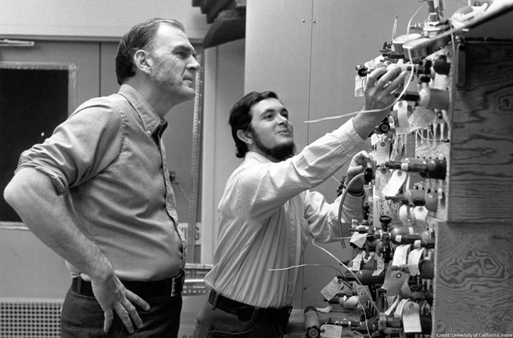
How? Sherwood and Molina showed that chlorine-containing molecules in refrigerator fluid played a key role in ozone destruction
Refrigerator fluid
This molecule is called a CFC (for chloro-fluoro carbon)
Sherwood and Molina’s work was done in the 1970s, before the ozone hole was even discovered!
This chlorine goes on to destroy ozone

Slide 27
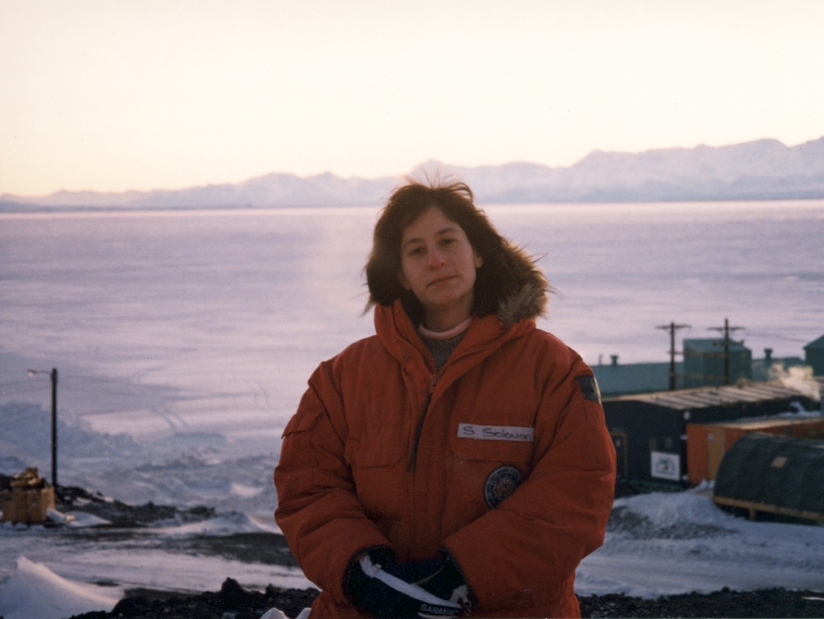
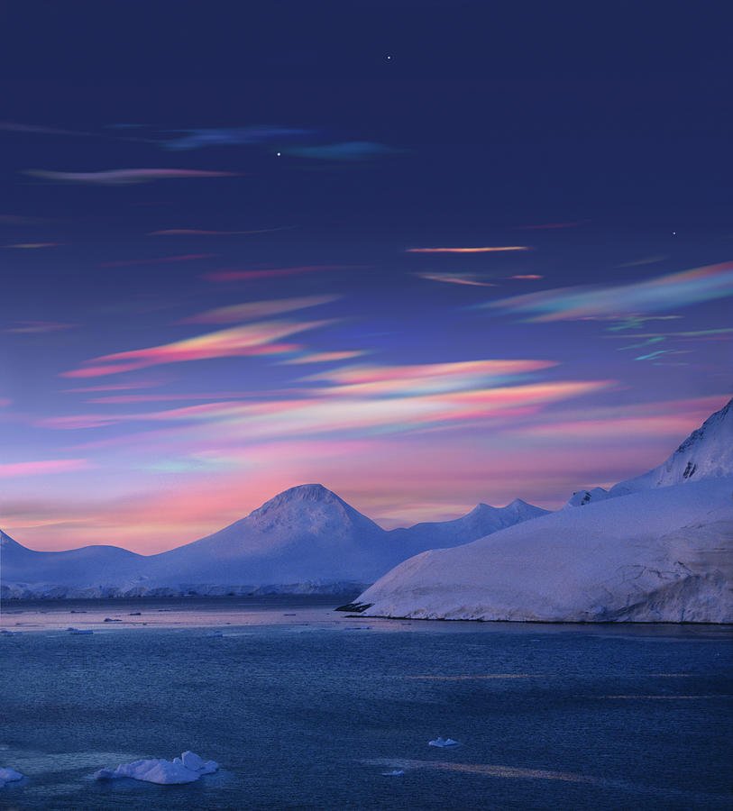
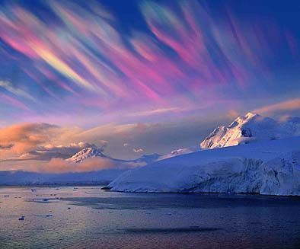
Solomon & coworkers showed that when the chlorine atoms attach to cloud surfaces, the destruction of ozone happens even faster
Chlorine in combination with a special type of cloud, called a polar stratospheric cloud, destroys ozone even faster

Slide 28
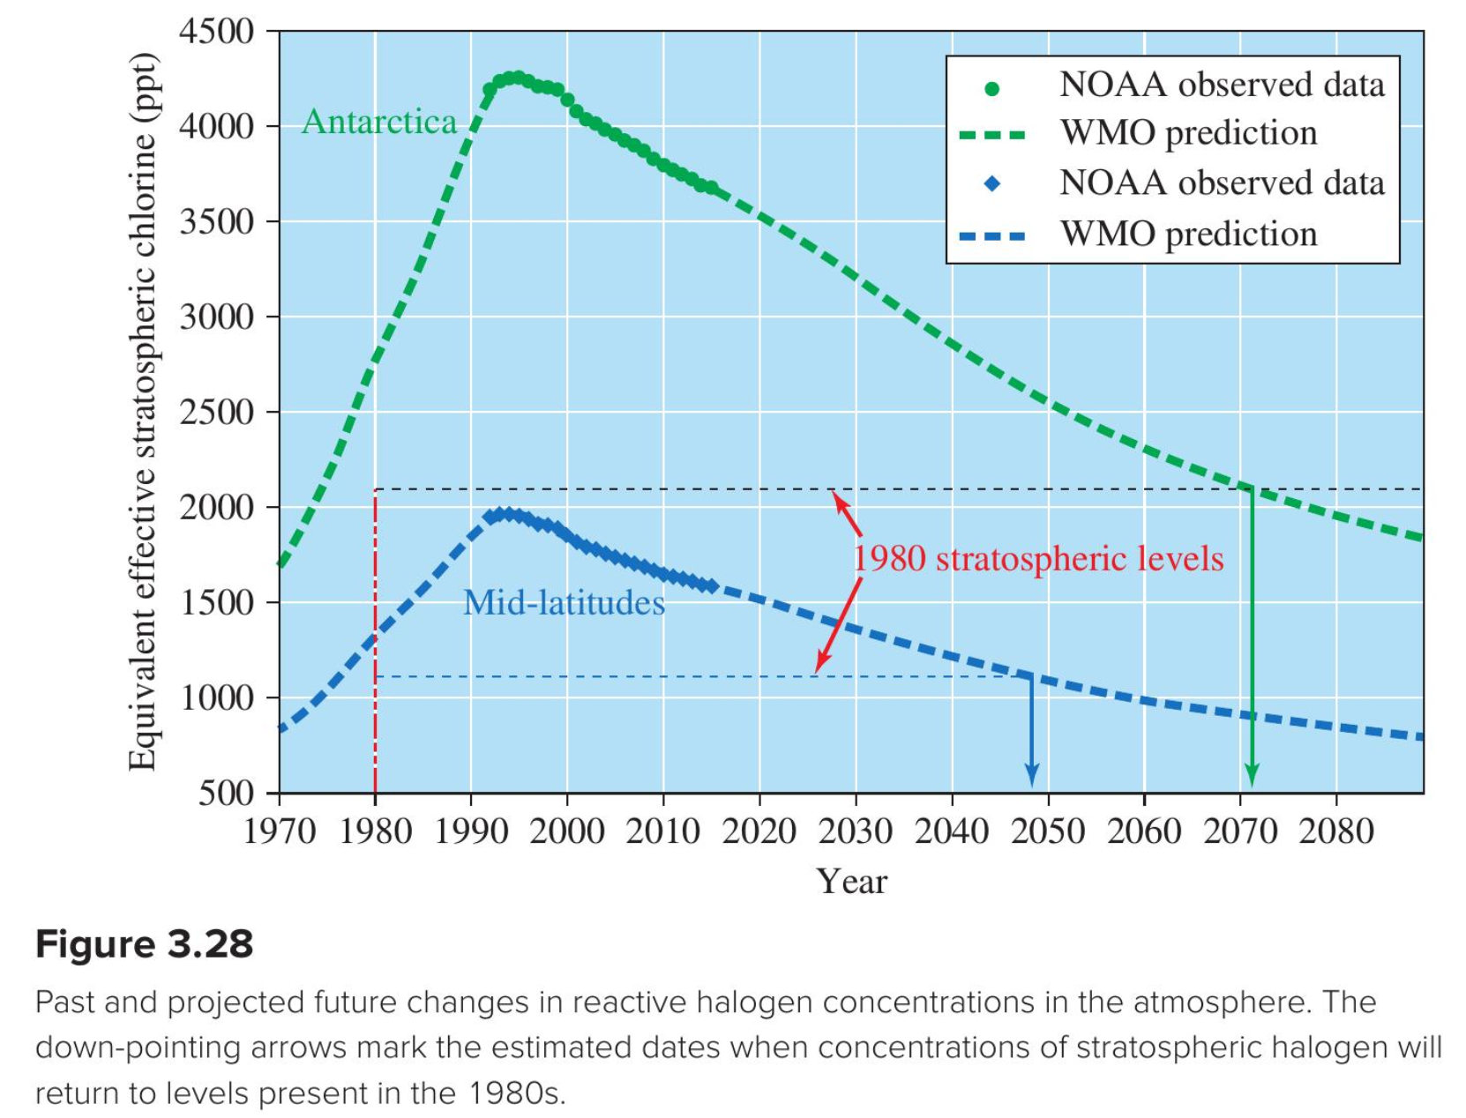
The Montreal Protocol (1992) reduced emissions of CFCs, so chlorine concentrations started to go down

Slide 29
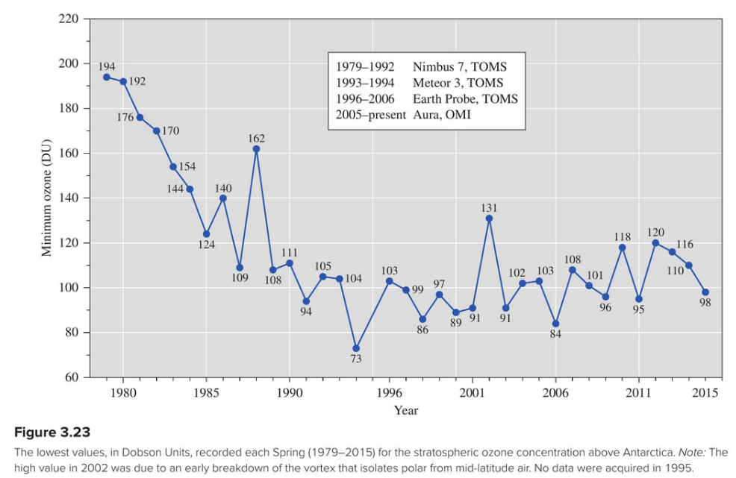
The reduction in stratospheric chlorine has led to a (slow) recovery of ozone

Slide 30
Take-home messages …
Ozone as a greenhouse gas:
Ozone is IR-active because the oxygen atoms have different (+/-) charges.
Ozone’s IR-active asymmetric stretch occurs in the atmosphere’s 8−12 𝜇𝑚 window – which makes it a potent greenhouse gas.
Because most ozone occurs in the stratosphere, its greenhouse gas activity results in a warmer stratosphere.
Stratospheric ozone destruction:
Refrigerant fluids called “CFCs”, when released to the atmosphere, have been making their way up to the stratosphere and getting split apart by sunlight, releasing atomic chlorine (Cl.).
The Cl. goes on to destroy stratospheric ozone.
The presence of polar stratospheric clouds greatly accelerates that destruction.
The Montreal Protocol (1992) reduced emissions of CFCs, so chlorine concentrations have started to go down, and stratospheric ozone has been slowly recovering.

Slide 31
Printed handouts below here

Slide 32
Absorption spectra of photosynthesizing pigments
Blue light should be pretty _____ for all pigments
Red light should be pretty _____ for chlorophyll but _____ for carotenoids
Blue-green light should be _____ for carotenoids but _____ for chlorophyll
Yellow light should be _____ for all pigments
https://www.researchgate.net/profile/Mohammad_Aboonajmi/publication/308657173/figure/fig1/AS:410895856488453@1474976615139/Absorption-spectra-of-chlorophyll-and-carotenoids-From-wwwcfbunhedu.png

Slide 33
Photosynthesis in a changing climate

